Slide 1
Region 3 – First Year Member Experience
November 13, 2014
Presented by: Lee Stogner
IEEE Membership Volunteer l.stogner@ieee.org 864-360-9415

Slide 2
Why are we here ?
To ensure that new members completely understand the value of IEEE
To help them find a professional home
To help members network within the IEEE community
Help with personal growth and identify IEEE alignment
Identify and link with a mentor
To help advance technology for humanity
To grow the IEEE

Slide 3
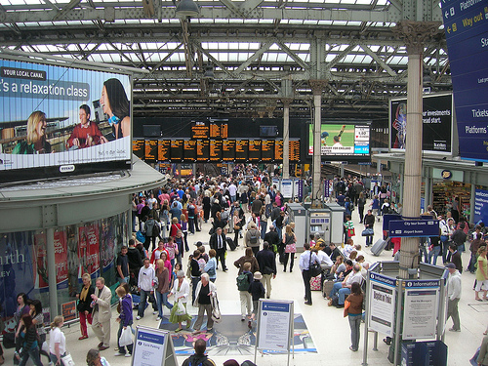
Slide 3
Recall your 1st experience at a large train station...

Slide 4


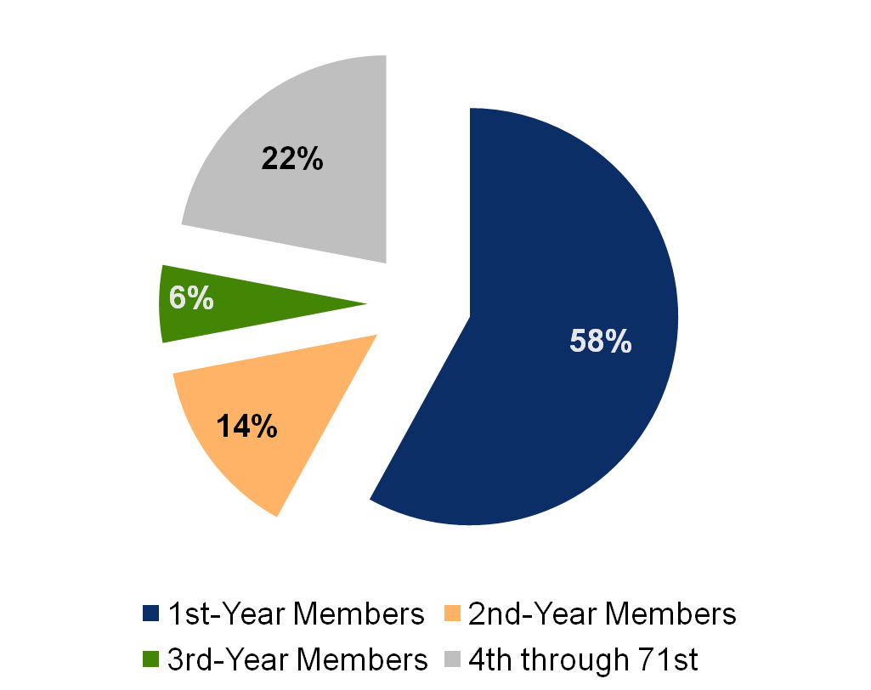
Total Attrition – Outflows, All Grades in a typical year

Slide 5
The IEEE Membership Challenge
The IEEE does a great job in getting new members
We just lose too many in the first, second, third and forth years
The attrition is basically the same whether you pick any three years since 2000
If we could do a better job in the early years, we could grow by 5% - 10% per year
Region 3 could double our size if each one of us signed up one new member, but we would still need to keep them

Slide 6
What do we do ?
Let’s do a survey
We have done lots of survey’s. We know our audience. People leave the IEEE because they don’t hear or understand our value against what they value for their time or money.
We can automate ourselves out of the problem
We can tell the one MD Chair in each Section / Chapter to work harder
Or, we can build a balanced Staff / Volunteer team backup up by tools, incentives, training, local support and a synchronized plan

Slide 7
The Technical
Current
Going Forward
Month 1
Campaign to register and attend New Member Orientation
Month 2
Month 4
Month 6
New Membership Year
Thank You postcard to all new members
Identify members that didn’t log into myIEEE or their IEEE Account
Mailing with gift
Congrats on 1 yr and reasons to renew communication
Satisfaction Survey
Ack Pack (electronic STU/GSM)
MGM
Ongoing monthly communication: Benefits Bulletin, WNFS, The Institute

Slide 8
The Human Touch
Using service organizations as a benchmark, develop a local Section / Chapter team that can,
  Immediately welcome new members with a local phone call and invitation to the next meeting
  Assume they know nothing about the IEEE and begin their education. Leverage Staff supported communications.
  Find out what their interests are
  At the next meeting, introduce the new member to members that can “set an example” and share similar interests
  Find them a volunteer role
  Stay in touch and ask what can we do better

Slide 9
Stay in sync with the IEEE
MD Volunteer Support
Outreach, coordination and collaboration with:
List/Lead Development
E-mail
Social media/viral programs
Events and Conferences
Metro Area Workshops
Large Society conferences
Industry conferences
Meeting & Conference Management Collaboration
Affinity Marketing Partnerships
IEEE Products
Non-IEEE Products
Joint membership agreements
Online advertising
IEEE-USA MGM Pilot
Regional MD Chairs
Section MD Officers
Section Chairs
Region meeting/ committee participation
2013 - 2014
2014

Slide 10
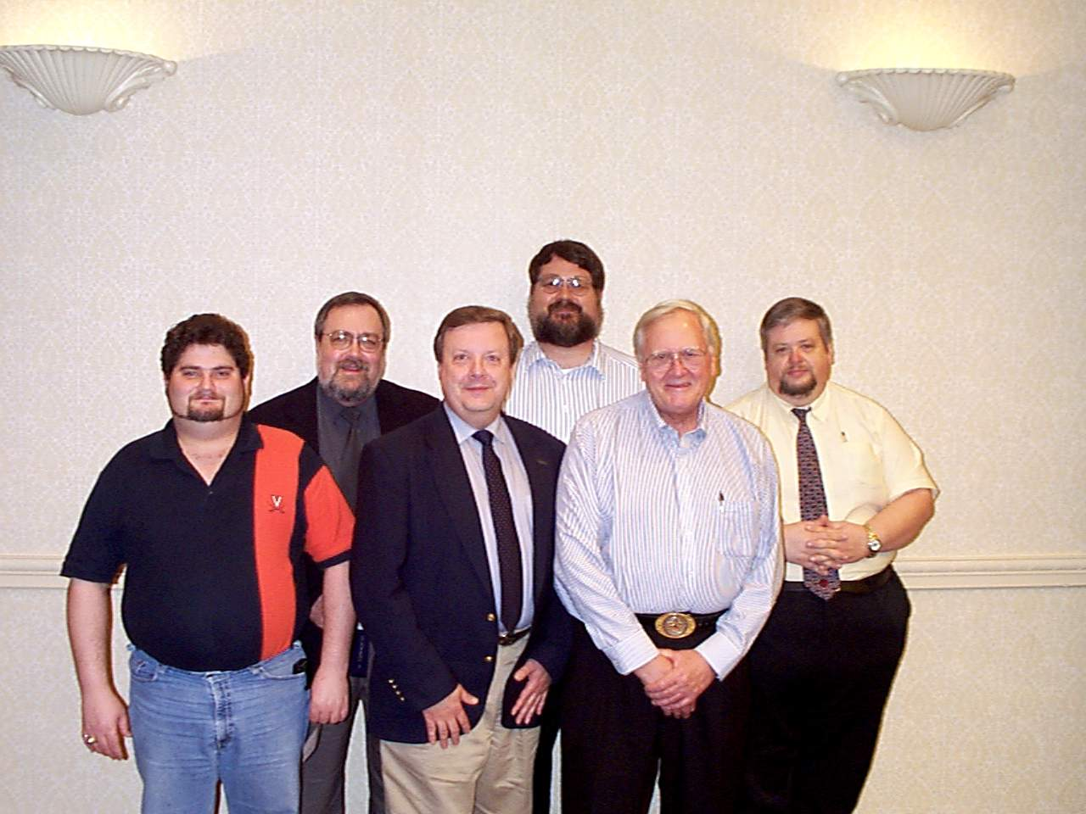
Summary
Build the local team and leverage its power

